Slide 1
Data-Driven Insights On Olympic Sports Participation And Performance

Slide 2
Introduction
The modern Olympic Games or Olympics are leading international sporting events featuring summer and winter sports competitions in which thousands of athletes from around the world participate in a variety of competitions. The Olympic Games are considered the world’s foremost sports competition with more than 200 nations participating. The Olympic Games are held every four years, with the Summer and Winter Games alternating by occurring every four years but two years apart.

Slide 3
Goals
Objective
Data-Driven Insights on Olympic Sports Participation and Performance is a project that aims to find insights by using Cognos Analytics
The use of athlete data analytics is transforming how athletes train, compete, and manage their careers. Technologies such as computer vision, machine learning, advanced wireless connectivity, and wearable sensors are transforming how athletes train, compete, and manage their careers
Examine interrupts and existed valuable insights from the row data and make a informed decision and identify patterns and trends and relationships and support the evidence based on conclusion it is a essential process in the various fields including business science research and moreover

Slide 4
Data collection
Data Collection & Extraction From Database
Data collection is the process of gathering and measuring information on variables of interest, in an established systematic fashion that enables one to answer stated research questions, test hypotheses, and evaluate outcomes and generate insights from the data.
Pellentesque habitant morbi tristique senectus et netus et malesuada fames ac turpis egestas. Proin pharetra nonummy pede. Mauris et orci.
Data Preparation
In this milestone, we will see how to prepare the data for building visualizations

Slide 5
Exploratory Data analysis
Exploratory Data Analysis (EDA)
It is a crucial step in the data analysis process. It involves visualizing and summarizing data to gain an initial understanding of its patterns, distributions, and relationships. EDA helps to identify outliers, missing values, and potential issues in the data before proceeding with more advanced analyses. By exploring the data through graphs, charts, and statistical measures, analysts can make informed decisions about which techniques to apply and what further insights to investigate.

Slide 6
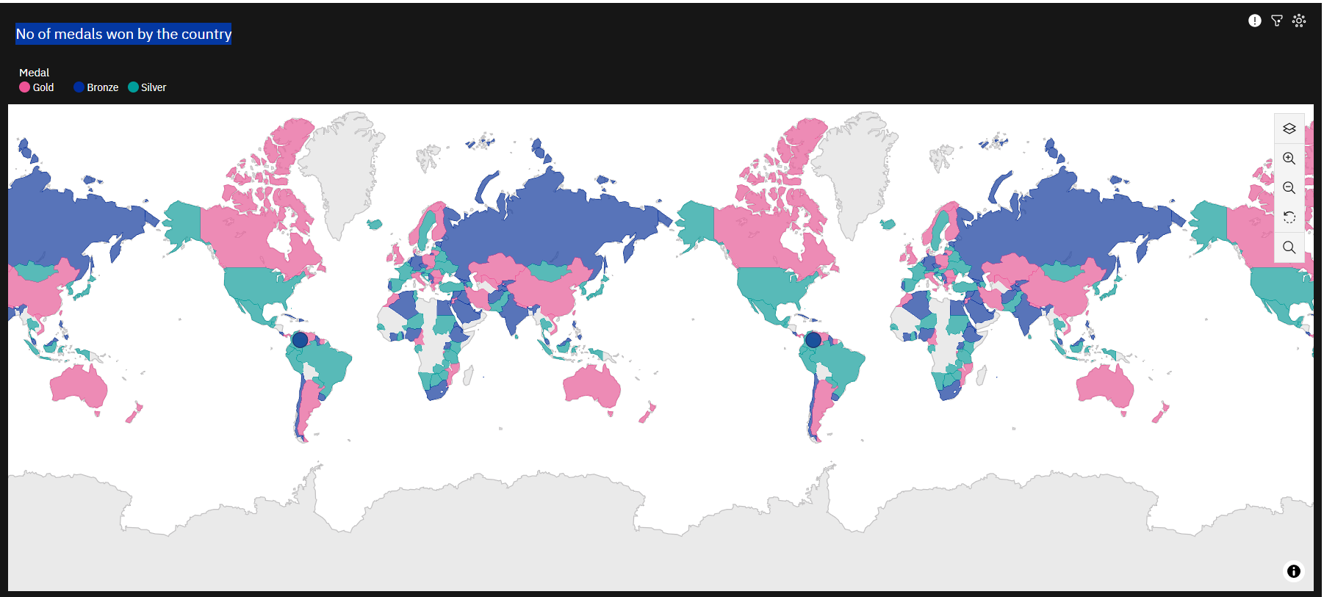
Top performing countries
Here analysis of countries with the most Olympic medals the factors of contributing to their successor

Slide 7
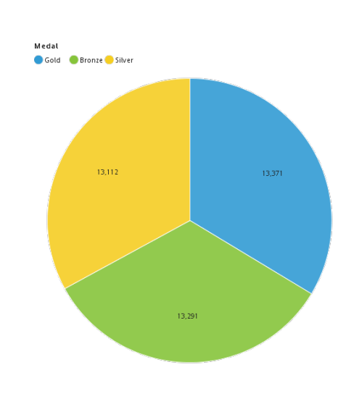
Gold have most No of medals won in Olympic

Slide 8
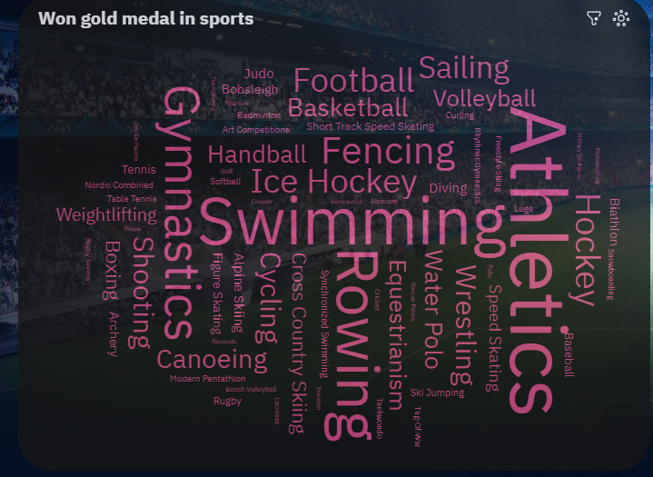

Most No of Gold medals won by team in diff sports

Slide 9
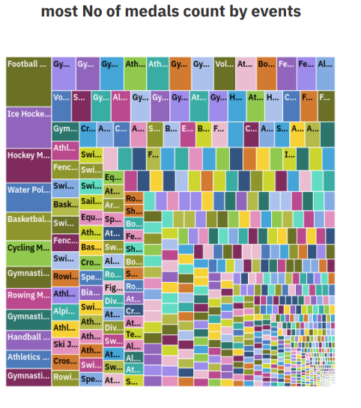
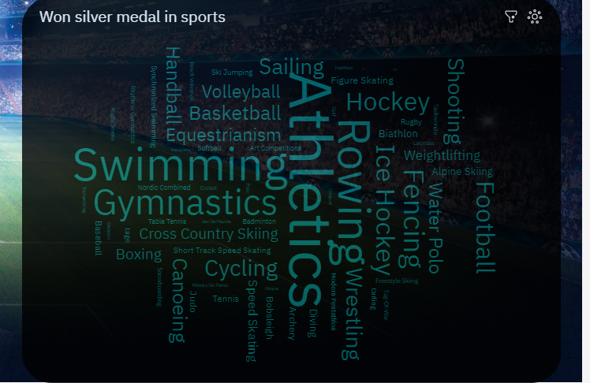
Most number of medals won in the sports through different events

Slide 10
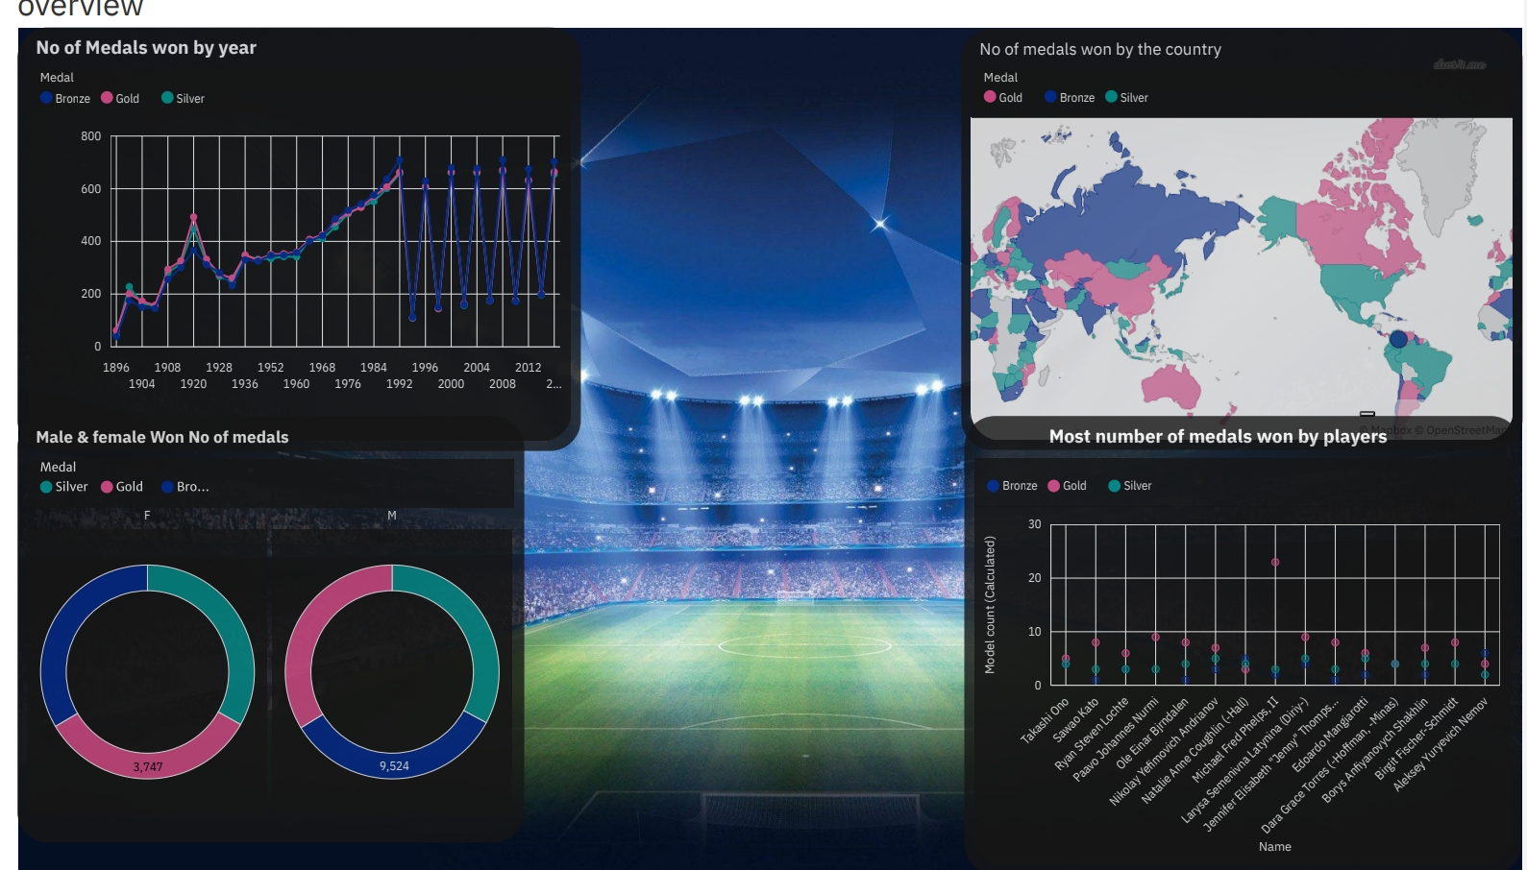
DASHBOARD CREATION IN IBM
The IBM Cognos we can use our data set in the different formats like csv , Excel and etc
Those files contain different types of data in the form of Excel so using the data we We can represent those data in the different visualisations to easily understand what actually has been done in that scenario.
Below image is an example of creation a dashboard

Slide 11
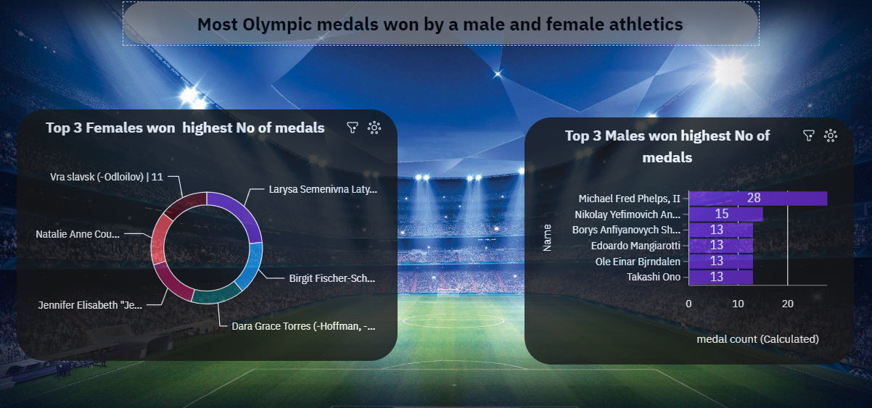
Story creation in IBM
The IBM Cognos we can use our data set in the different formats like csv and etc
Those files contain different types of data in the form of Excel so using the data we We can represent those data in the different visualisations to easily understand what actually has been done in that scenario.
Below image is an example of creation a story

Slide 12
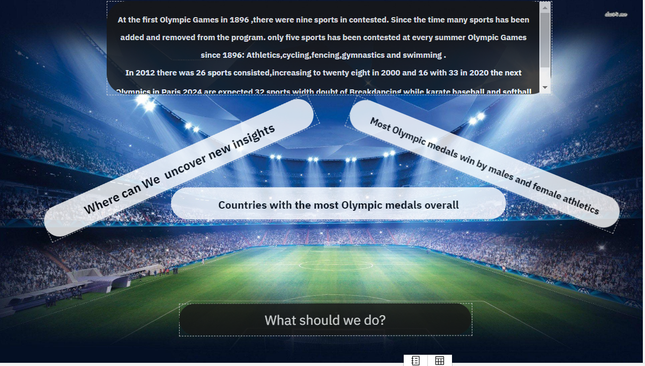
Report creation in IBM
Report creation in IBM is a one type of visualisation which can be used to view different views of our data like a This was this was done in different types that can be stored in HTML PDF XML and different types of aspects

Slide 13
Thank you

